Slide 1

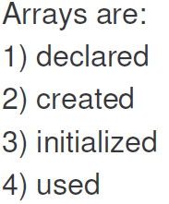



Slide 2

Index begins with 0.
if the index goes beyond the allocated capacity, (As it cannot be determined at compile time), ArrayIndexOutOfBoundsException is thrown at Run-time

Slide 3
Lets create some arrays: int array:
int ia[ ] ; //Declaration
//int [ ] ia ; also OK
a=new int [10];
char array:
char ca [ ];
ca= new char [5];
and so on..
arrays ( Local as well as instance ) are automatically initialized to the default value for the type
e.g. int → 0 , float → 0.0 , boolean → false
char → '\u0000‘ (NULL)

Slide 4
Example: Create an int array to store 10 elements and print default values in Tabular format
public class InitArray
{
public static void main( String[ ] args )
{
int[ ] a; // declare array named array
a= new int[ 10 ]; // create the array object
//ALSO possible int[ ] a=new int [ 10 ];
System.out.printf( "%s%8s\n", "Index", "Value" );
// output each array element's value
for ( int index= 0; index < a.length; index ++ )
System.out.printf( "%5d%8d\n", index, a [index] );
} // end main
} // end class InitArray
Output next slide…

Slide 5
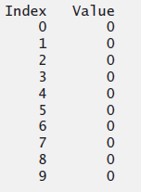
Output:
Note: arrays are automatically initialized ( Local as well as instance )

Slide 6
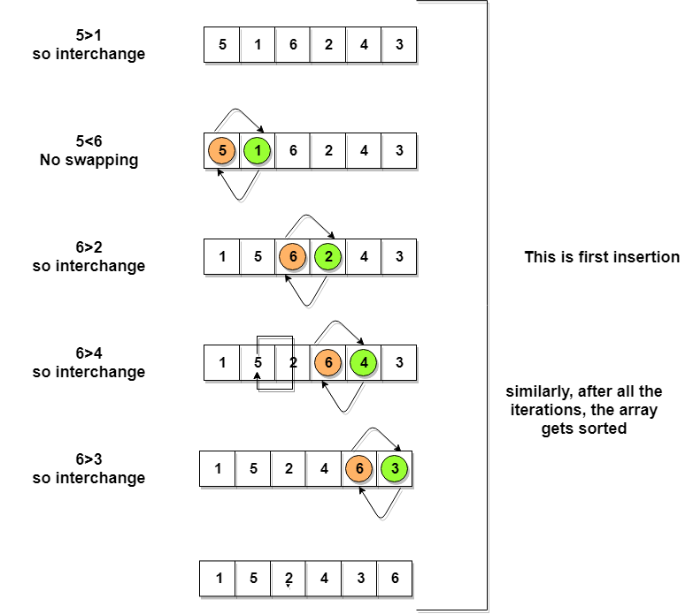
Declare and initialize an Array
Write a program to implement Bubble sort using array

Slide 7
Declare and initialize an Array
Write a program to implement Bubble sort using array
We understand: (1) How to declare and initialize array (2) How to write a method that has array as parameter (3) How to pass an array
class BubbleSort
{ //Method of a class
void bubbleSort( int arr[ ] ) //Param
{
int n = arr.length;
for (int i = 0; i < n-1; i++)
for (int j = 0; j < n-i-1; j++)
if (arr[j] > arr[j+1])
{
// swap
int temp = arr[j];
arr[j] = arr[j+1];
arr[j+1] = temp;
}
} //end of bubbleSort
/* Prints the array */
void printArray (int arr[ ])
{
int n = arr.length;
for (int i=0; i<n; ++i)
System.out.print(arr[i] + " ");
System.out.println();
} //end of printArray
public static void main(String args[])
{
int arr[ ] = {64, 34, 25, 12, 22, 11, 90}; //Initial
BubbleSort ob = new BubbleSort();
ob.bubbleSort(arr); //passing array
System.out.println("Sorted array");
ob.printArray(arr);
} //end of main
} //End of class

Slide 8
Declare and initialize an Array
Output:
Sorted array: 11 12 22 25 34 64 90
Homework:
Write a program to print the marks (out of 100 ) obtained by 15 students of a class. Display each students roll no and marks. Display class average, max and min marks obtained.

Slide 9
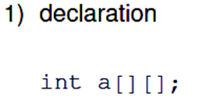

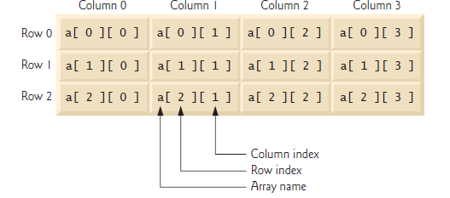
3. Initialization
for(i=0; i< 2; i++)
{
for(j=0; j< 3; j++)
{
a [ i ][ j ] = 20;
}
}
Also: Declare and Initialize

Slide 10
Write a Program to transpose a 2D matrix. i.e. rows to column
class 2DTranspose
{
public static void main(String args[ ])
{
int a1[ ][ ]=new int [3][4];
int a2[ ][ ]=new int [4][3];
int count=0; // for initializing matrix a1
//Initialize the content of Matrix a1
for(int i=0; i<a1.length; i++)
{
for (int j=0; j<a1[ i ].length; j++)
{
a1[ i ][ j ]=count++; //Some values
System.out.print (a1[i][j]+" "); //Display matrix contents
}
System.out.println();
} //end of for i

Slide 11
//Transpose
for(int i=0; i<a1.length; i++)
{
for (int j=0; j<a1[i].length; j++)
{
a2[ j ][ i ]=a1[ i ][ j ]; //Logic copy from i, j to j, i
}
}
//Display the Transpose
for(int i=0; i<a2.length; i++)
{
for (int j=0; j<a2[i].length; j++)
{
System.out.print (a2[ i ][ j ]+" ");
}
System.out.println();
}
}//End of main
}//End of class

Slide 12
Variable column matrix
Problem statement : Declare an array with two rows. First row has two columns and second row has four columns
int aryInt [ ][ ]= new int[2][ ]; //second dimension not mentioned
aryInt [0]= new int[2];//row 1 (index 0) has two elements
aryInt[1]=new int [4]; //row 2 (index 1) has four elements

Slide 13
Variable column matrix
Program: Write a java program for creating the two dimensional integer matrix as shown below. Initialize the elements and print the values.
Solution on the next slide…

Slide 14
Class AryTest
{
public static void main(String [] args)
{
int arry[ ][ ];//Matrix reference
arry= new int [3][ ];//Specify only rows
// Create columns for each row
arry[0]=new int[2];
arry[1]=new int[4];
arry[2]=new int[3];
for (int i=0; i<arry.length; i++)//Initialize elements
{
for (int j=0; j< arry[i].length; j++)
{
arry[i][j]= i + j;//Initialize with some value
}
}

Slide 15
//Display the contents of matrix
for (int i=0; i<arry.length; i++)
{
for (int j=0; j<arry[i].length; j++)
{
System.out.print (" "+arry[i][j]);
}
System.out.println();
}
}//End of main
}//end of class Click to see the output
0 1
1 2 3 4
2 3 4

Slide 16
134
Lets understand Dynamic creation of an array.
Write a program to read the size and elements of an integer array from the user. Display the elements
Solution on the next slide…

Slide 17
Import java.util.Scanner;
class DynamicArray {
public static void main(String args[ ])
{
Scanner sc=new Scanner(System.in);
System.out.print("Enter the size of int array ");
int size=sc.nextInt();
int a[ ]=new int[size];
System.out.println("Enter the elements of an array ");
for (int i=0;i<a.length; i++)
{
a[i]=sc.nextInt();
}
System.out.println("You have entered: ");
for (int i=0;i<a.length; i++)
{
System.out.println(a[i]);
}
}

Slide 18

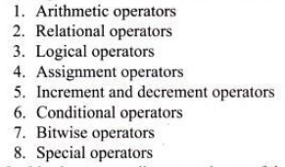

Slide 19



Slide 20
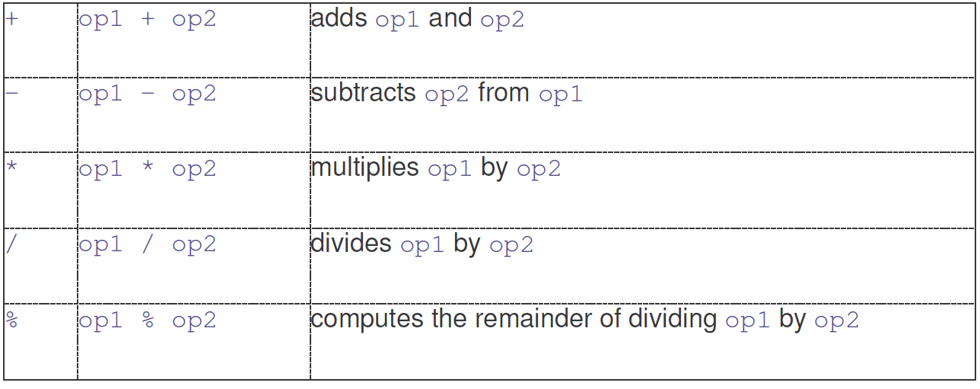

Slide 21

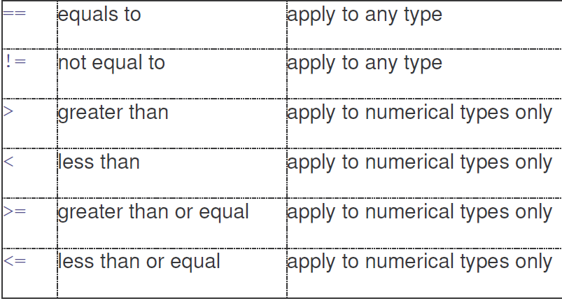

Slide 22

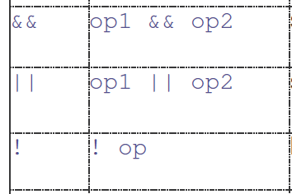

Slide 23
public class Comparison
{
public static void main(String[] args)
{
int n = 2;
if (n != 0 && n > 10)
System.out.println("This is true");
else
System.out.println("This is false");
}
}

Slide 24
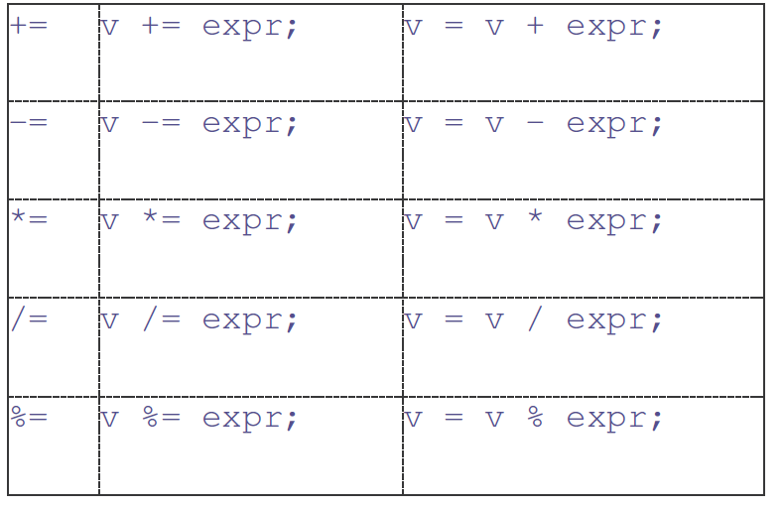

Slide 25


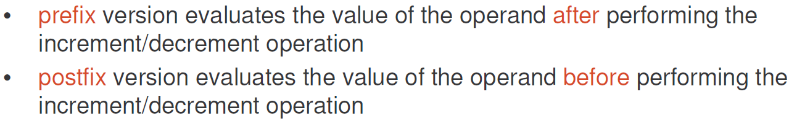

Slide 26
class IncDec
{
public static void main(String args[ ])
{
int a = 1;
int b = 2;
int c, d;
c = ++b;
d = a++;
c++;
System.out.println(“a= “ + a);
System.out.println(“b= “ + b);
System.out.println(“c= “ + c);
}
}

Slide 27
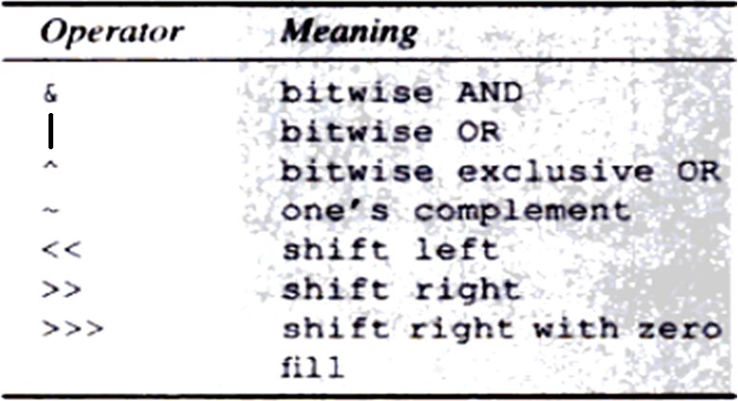
Conditional Operator
Bitwise Operator

Slide 28

Special Operators
boolean b= manager instanceof BankEmployee;

Slide 29

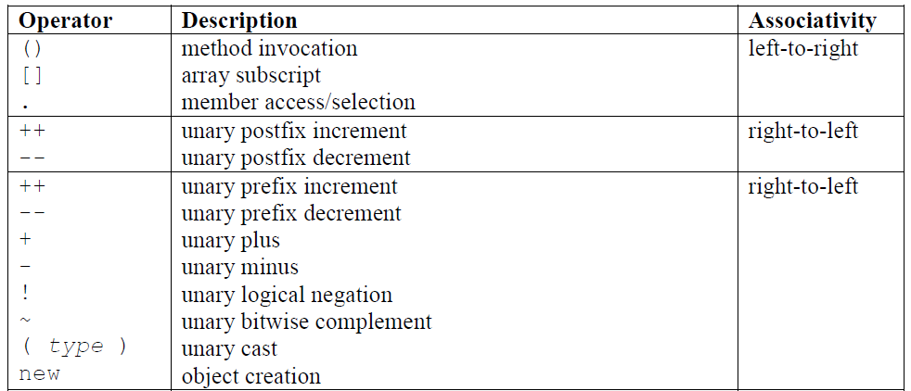

Slide 30
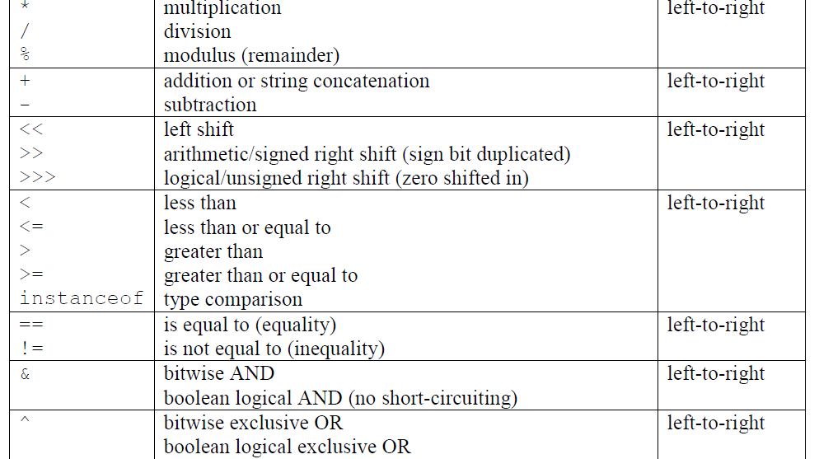

Slide 31
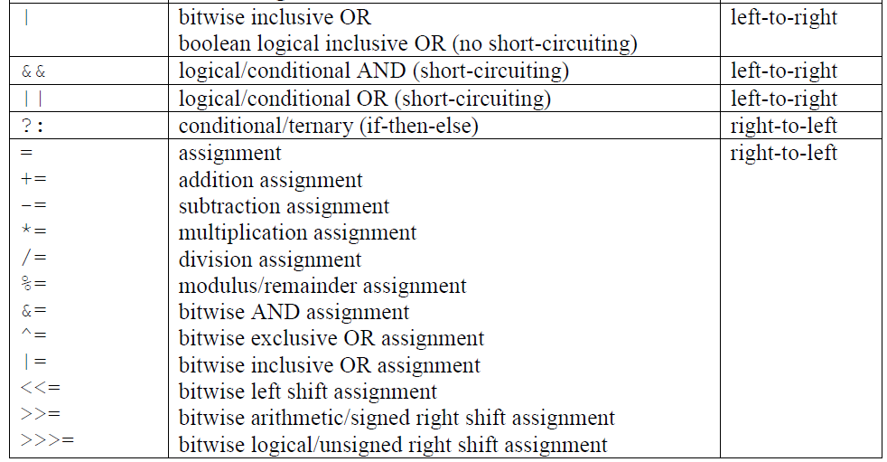

Slide 32

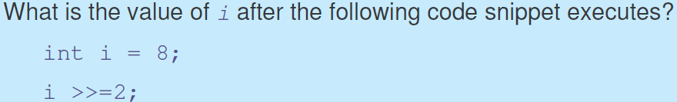

Slide 33


Slide 34
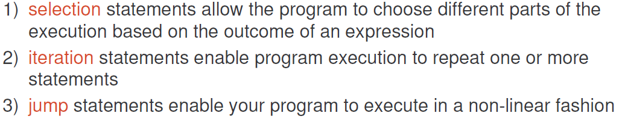

Slide 35

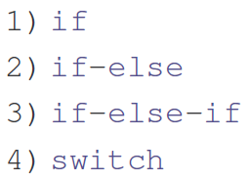
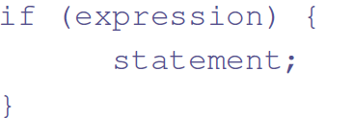

Note: Expression must evaluate to true or false

Slide 36
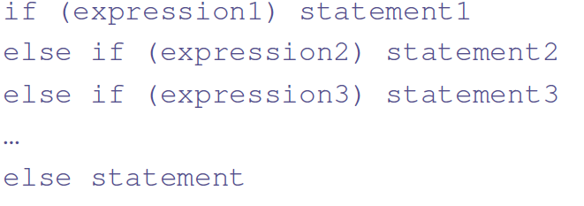
Read a month in numeral and display the season using if-else as below:
Month | Season
12, 1, 2 | Winter
3, 4, 5 | Spring
6, 7, 8 | Summer
9, 10, 11 | Autumn

Slide 37
Lets write a program
Read a month in numeral and display the season using if-else as below:
Month | Season
12, 1, 2 | Winter
3, 4, 5 | Spring
6, 7, 8 | Summer
9, 10, 11 | Autumn

Slide 38
class IfElse
{
public static void main(String args[])
{
int month = 4;
String season;
if (month == 12 || month == 1 || month == 2)
season = "Winter";
else if(month == 3 || month == 4 || month == 5)
season = "Spring";
else if(month == 6 || month == 7 || month == 8)
season = "Summer";
else if(month == 9 || month == 10 || month == 11)
season = "Autumn";
else season = "Bogus Month";
System.out.println("April is in the " + season + ".");
}
}

Slide 39

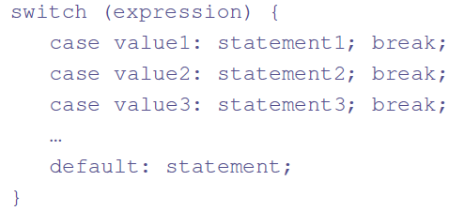
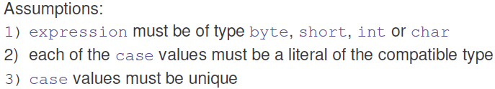
In the JDK 7 release, you can use a String object in the expression of a switch statement:

Slide 40
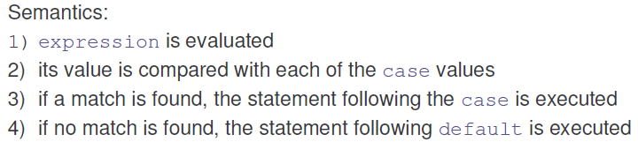
e.g.
int a=2;
switch (a)
{
case 1:….. break;
case 2 :….. break;
default:
}
String s1=“data1”;
switch (s1)
{
case “data1”:….. break;
case “data2”:….. break;
default:
}
Write the seasons program using switch statement

Slide 41
Program: Given a month in numerals, print the season of the Year (i.e. Winter, Spring, Summer and Autumn)
e.g. enter a month
2
Winter
class Switch
{
public static void main(String args[])
{
int month = 4;
String season;
switch (month)
{
case 12:
case 1:
case 2: season = "Winter"; break;
case 3:
case 4:
case 5: season = "Spring"; break;
case 6:
case 7:
case 8: season = "Summer"; break;

Slide 42
case 9:
case 10:
case 11: season = "Autumn"; break;
default: season = "Bogus Month";
}
System.out.println("April is in " + season + ".");
}
}

Slide 43
Write a Program to simulate a simple calculator. Add, subtract, multiply and divide using switch statement

Slide 44
double num1=0, num2=0, result=0;
Scanner sc=new Scanner(System.in);
System.out.print("Enter the first value: ");
num1=sc.nextDouble();
System.out.print("Enter the second value: ");
num2=sc.nextDouble();
System.out.print("Enter the operator +, -, * or /: ");
char op= sc.next().charAt(0);
switch (op)
{
case '+': result=num1+num2;
break;
case '-': result=num1-num2;
break;
case '*': result=num1*num2;
break;
case '/': result=num1/num2;
break;
default: System.out.append("Wrong operator");
return;
}
System.out.println(num1+" "+op+" "+num2+"="+result);

Slide 45
Nested Switch statement using two variables i and j
int i = 0;
int j = 1;
switch(i)
{
case 0:
switch(j)
{
case 0:
System.out.println("i is 0, j is 0"); break;
case 1:
System.out.println("i is 0, j is 1"); break;
default:
System.out.println("nested default case!!");
}
break;
default: System.out.println("No matching case found!!");
}

Slide 46
Write a program to demonstrate the nested switch statement as below:
Read the value of i and j as integer and print the message for following conditions:
i | j | Message
0 | 0 | Task T1
0 | 1 | Task T2
1 | 0 | Task T3
1 | 1 | Task T4
Else invalid task

Slide 47
Scanner sc=new Scanner(System.in); //Scanner object
System.out.print("Enter the values of i and j: ");
int i=sc.nextInt();//Read the values
int j=sc.nextInt();
switch(i)// Initially switch on the value of “i”
{
case 0:
switch(j)
{
case 0:System.out.println("task1"); break;
case 1:System.out.println("task2"); break;
default: System.out.println("Invalid value of j");
}
break;

Slide 48
case 1:
switch(j)
{
case 0:System.out.println("task3"); break;
case 1:System.out.println("task4"); break;
default: System.out.println("Invalid value of j");
}
break;
default:
System.out.println("Invalid task");
break;
}

Slide 49




Slide 50
class DoWhile
{
public static void main(String args[])
{
int i;
i = 0;
do
i++;
while ( 1/i < 0.001);
System.out.println(“i is “ + i);
}
}

Slide 51
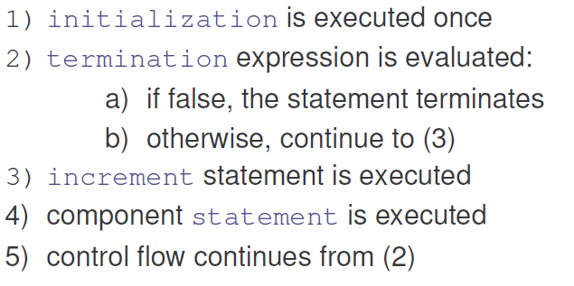

Slide 52
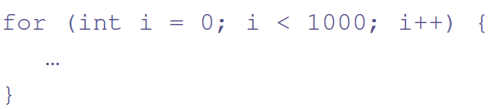
Initialization can have byte, short, int, long data types. Although you can use float and double as well but use it with caution
Lets see an example

Slide 53
Write a Program to check if the given integer is a Prime number?

Slide 54
class FindPrime
{ //Check if the number is prime
public static void main(String args[])
{
int num = 14;
boolean isPrime = true;
for (int i=2; i < num/2; i++) //Usually SQRT(num)
{
if ((num % i) == 0)
{
isPrime = false;
break;
}
}
if (isPrime) System.out.println("Prime");
else System.out.println("Not Prime");
}
}

Slide 55
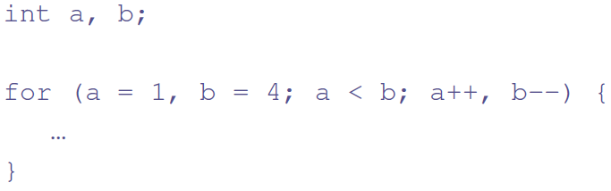

Slide 56
class ForVar
{
public static void main(String args[])
{
int i = 0;
boolean done = false;
for( ; !done; )
{
System.out.println("i is " + i);
if(i == 10)
done = true;
i++;
}
}
}

Slide 57
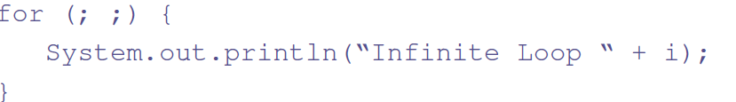
Refer Symmetric problem in
Interesting Programs arrays and matrix

Slide 58
Lets understand the Java’s Command Line Argument Processing
Write a program to read the command line arguments and print them.
Class CommandLine
{
public static void main (String args[ ])
{
int argLength=args.length; //Store in argLength
System.out.print ("Command Line arg demo");
System.out.print (“ No. of arguments”+argLength);
for(int i=0; i< argLength; i++)
{
System.out.print(args[i]+ " ");
}
System.out.println("=====");
}

Slide 59
Lets Program the following
Write a Program to read two integers from user and print the largest and smallest
Write a Program to read three integers from user and the prints sum, average, product, smallest and largest of the numbers
clue for program 2 on next page……….

Slide 60
Lets Program the following
// convert numbers from type String to type int
number1 = Read from Keyboard
number2 = Read from Keyboard
number3 = Read from Keyboard
// initialize largest and smallest
largest = number1;
smallest = number2;
// determine correct values
if ( number2 >= number1 )
{
largest = number2;
smallest = number1;
}
if ( number3 > largest )
largest = number3;
if ( number3 < smallest )
smallest = number3;

